Slide 1
Medicare Fees For Service & Supplier Costs Including Order & Referring
Including PART_B, HHA, DME, PMD & Average Wait Times Between Providers
By: Tyler Mann

Slide 2
Goal Of Analysis
Use of Google Cloud Platform and Trifacta to clean the three datasets and analyze any outliers found within the three datasets for further research. Are the patients getting the medical care needed, are there opportunities for other medical device, drug, and equipment companies. Lastly can further research determine the cause of outliers dealing with cost or supplier services.

Slide 3
Medicare (Part B) Background
Part B is for services or supplies that are needed to diagnose or treat your medical condition and that meet accepted standards of medical practice. You pay nothing for most preventive services if you get the services from a healthcare provider who accepts Part B.
Part B covers clinical research, ambulance services, Durable Medical Equipment (DME) and Power Mobility Devices (PMDs).
Physicians must be enrolled in Medicare unless they are approved for “opt-out” status. They must apply for this designation.

Slide 4
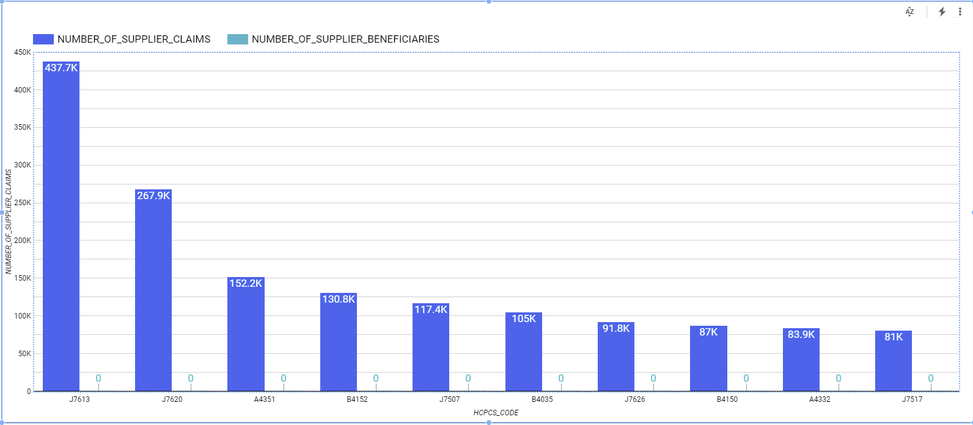
The high number of supplier claims since there’s no beneficiaries to supply product to. What are they needing all the medical supplies?
J7613 – Albuterol Inhalation Solution
J7620 – Albuterol & Ipratropium Bromide
A4351 – Unary Catheter
B4152 – Enternal Formula Feeding Tube
J7507 – Tacrolimus Oral Medicine
B4035 – Enternal Feeding Kit
J7626 – Budesonide Inhalation Solution
B4150 – Eternal Formula Feeding Tube
A4332 – Lubricant Sterile Packet
J7517 – Mycophenolate Mofetil Oral

Slide 5
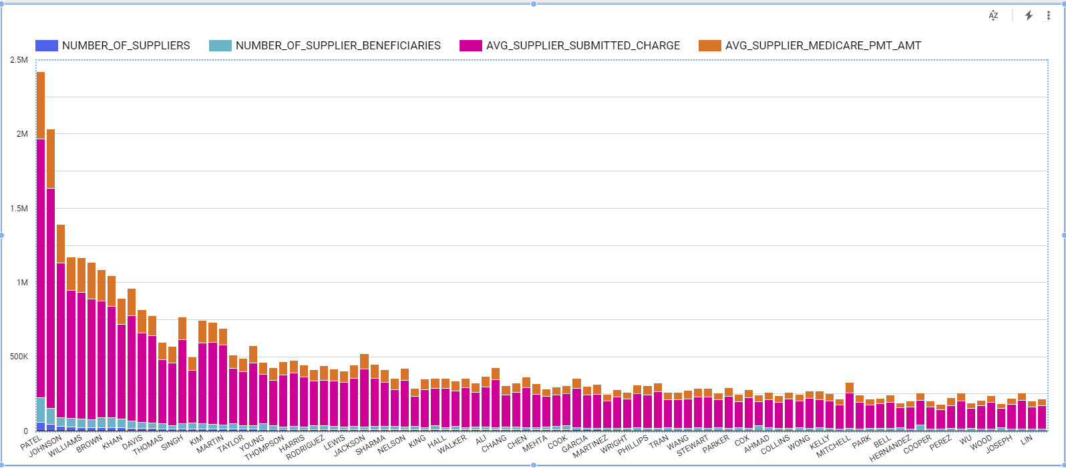
Since the charges submitted by the suppliers to Dr. Patel and Dr. Johnson are so much higher, maybe I let a competitor know if they come in with a lower price, they could win their business. Why are supplier charges so high?

Slide 6
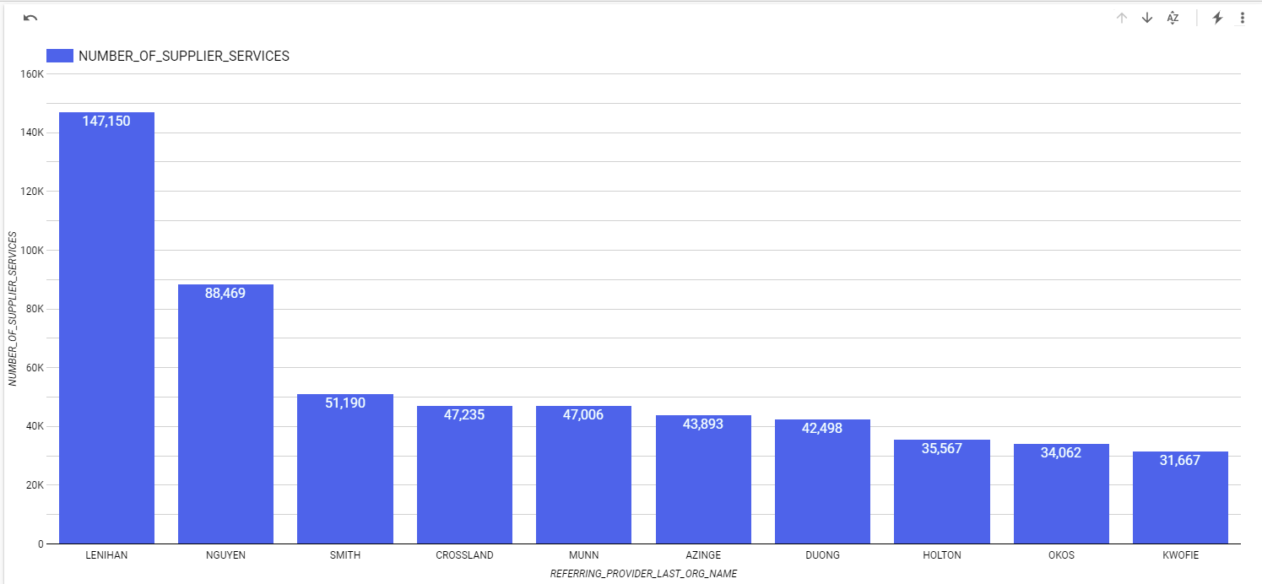
These charts show doctors who don’t have REFERRING_CREDENTIALS so decided to look further into these and the number of suppliers

Slide 7


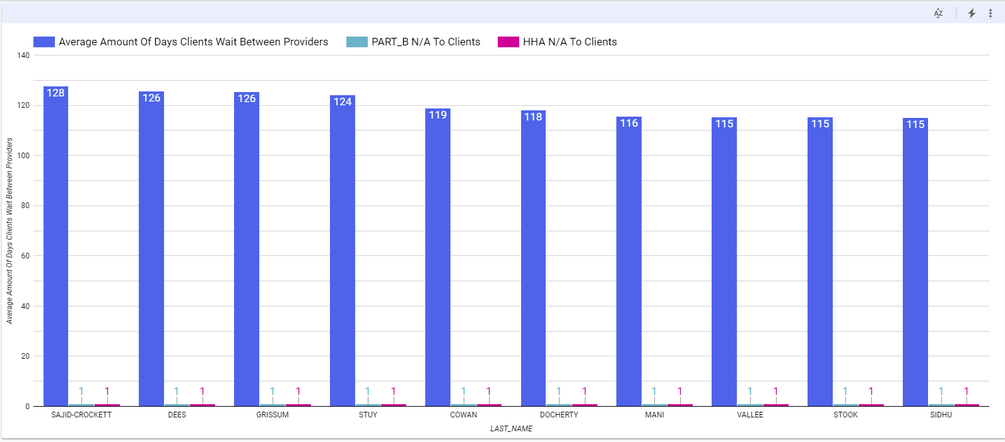
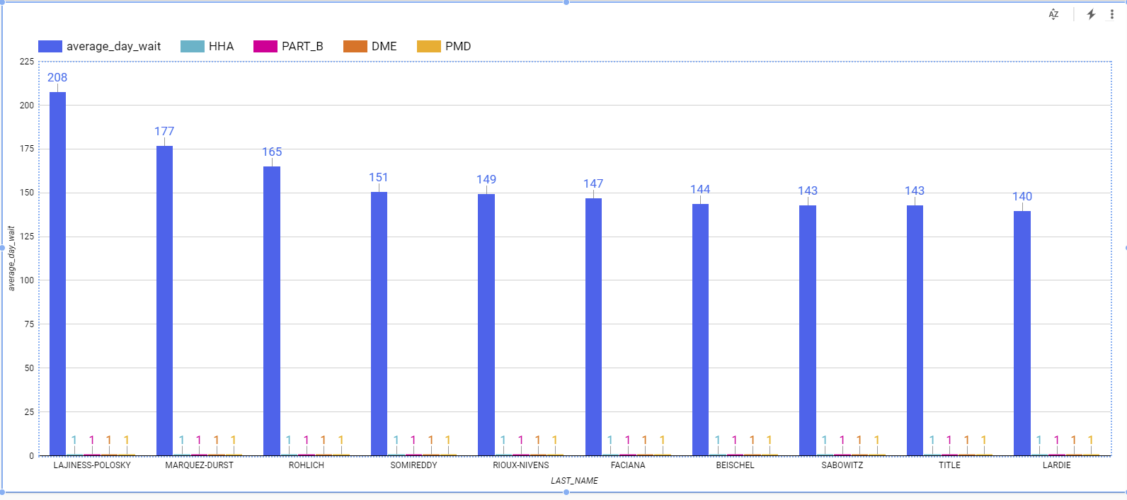
When looking at Providers who offer HHA & PART_B vs those Providers that don’t you would believe there would be a difference in the number of days between service. There’s not.

Slide 8
Conclusion
The data showed possible opportunity for a competitor to offer better supply rates.
The supply claims made by doctors lacking credentials.
There’s no significant difference between PART B and HHA providers vs non-PART B and non-HHA providers when looking at average wait time.
Large number of supplier claims with no beneficiaries.

Slide 9
References
Cms. “Provider Information for 1811989445.” NPPES NPI Registry, npiregistry.cms.hhs.gov/registry/provider-view/1811989445.
“Physician Self Referral.” CMS, www.cms.gov/Medicare/Fraud-and-Abuse/PhysicianSelfReferral.
MEDICAID DATA SOURCES - GENERAL INFORMATION | CMS
Cms.gov. 2021. Medicaid Data Sources - General Information | CMS. [online] Available at: <https://www.cms.gov/research-statistics-data-and-systems/computer-data-and-systems/medicaiddatasourcesgeninfo> [Accessed 12 April 2021].
Cms.gov. 2021. Medicaid Data Sources - General Information | CMS. [online] Available at: <https://www.cms.gov/research-statistics-data-and-systems/computer-data-and-systems/medicaiddatasourcesgeninfo> [Accessed 12 April 2021].
CareSet Systems. 2021. CareSet Dataset: DocGraph Hop Teaming Documentation - CareSet Systems. [online] Available at: <https://careset.com/datasets-3/hop-teaming/> [Accessed 12 April 2021].
Medicare.gov. 2021. Durable Medical Equipment Coverage. [online] Available at: <https://www.medicare.gov/coverage/durable-medical-equipment-dme-coverage> [Accessed 12 April 2021].
Data.cms.gov. 2021. [online] Available at: <https://data.cms.gov/Medicare-Durable-Medical-Equipment-DME-/Medicare-Referring-Provider-DMEPOS-PUF-CY2018/qxg2-8iki> [Accessed 12 April 2021].
Interim HealthCare. 2021. Home Health Aides (HHA) and Certified Nursing Assistants (CNA) - What’s the Difference?. [online] Available at: <https://www.interimhealthcare.com/saltlakecityut/blog/february-2016/home-health-aides-(hha)-and-certified-nursing-assi/#:~:text=The%20main%20responsibility%20of%20a,%2C%20eating%2C%20and%20hygiene%20needs.> [Accessed 12 April 2021].
Psoriasis.org. 2021. Medicare Part A, B, C and D: What’s the Difference?. [online] Available at: <https://www.psoriasis.org/advance/medicare-part-a-b-c-and-d-whats-the-difference/?gclid=CjwKCAjwjbCDBhAwEiwAiudBy_LktGC190GBZPVbUnX0f9t-w1OYjjNmMQ4H7VB2HcU_IhkSfB_g1BoCDdsQAvD_BwE> [Accessed 12 April 2021].
Data.cms.gov. 2021. [online] Available at: <https://data.cms.gov/Medicare-Durable-Medical-Equipment-DME-/Medicare-Referring-Provider-DMEPOS-PUF-CY2018/qxg2-8iki> [Accessed 12 April 2021].
Data.cms.gov. 2021. [online] Available at: <https://data.cms.gov/Medicare-Enrollment/Order-and-Referring/qcn7-gc3g> [Accessed 12 April 2021].

